Slide 1
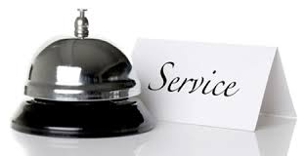
CUSTOMER SERVICE: Unit 2

Slide 2
UNIT OBJECTIVES
Unit 2 – Developing Customer Loyalty
The Laws of Service
Moments of Truth
Creating Customer Loyalty
Customer Turnoffs
Zone of Indifference
Service Culture

Slide 3
FIRST LAW OF SERVICE
The First Law of Service dictates that:
Satisfaction = Perception – Expectation
The first important point about this law is that both variables, perception and expectations are psychological phenomena.
One common mistake that service providers make is to judge performance or customer expectations based on what they feel the customer should think – not what the customer actually thinks.
This law also says that if customers expect a certain level of service and perceive that an equal or higher level was delivered, they will be satisfied.
On the other hand, even when the service was good (by objective standards) is delivered, if the expectation was for better service, customers will be dissatisfied.

Slide 4
FIRST LAW OF SERVICE
Perception can be defined as a marketing concept that encompasses a customer's impression, awareness and/or consciousness about a company or its offerings.
Customer perception is typically affected by advertising, reviews, public relations, social media, personal experiences and other channels. Different customers may perceive the same product or service in different ways.
Customer satisfaction is a marketing term that measures how products or services supplied by a company meet or surpass a customer's expectation.
Customer satisfaction is an abstract concept and involves such factors as the quality of the product, the quality of the service provided, the atmosphere of the location where the product or service is purchased, and the price of the product or service.

Slide 5
FIRST LAW OF SERVICE
For customer-contact personnel to deliver service that meets customers' expectations, they must first understand what it is that the typical customer expects. "Customer expectation" refers to the total perceived benefits a customer expects from a company's product or service. If the actual experience customers have with a product exceeds the expectation, they are typically satisfied.
These expectations fall into seven basic categories: Accessibility - Courtesy - Personal Attention - Empathy - Job Knowledge - Consistency - Teamwork.
Accessibility. Customers expect prompt and efficient service. This means that they must be able to get to someone in the organization who can help them. Whether it is waiting for initial processing or talking to someone about fixing a problem, they do not expect to go through a maze of paperwork and red tape. They want their questions answered and their needs met as soon as possible.

Slide 6
FIRST LAW OF SERVICE
Courtesy. Customers expect to be treated in a professional manner. They react poorly to rudeness. Even in a situation where nothing can really be done to fix a problem, a kind word will go a long way toward soothing ruffled feathers. Customers expect their property to be treated with respect as well. Employees should treat customers' luggage, cars, and so on, as if it were their own. They also expect a neat and clean appearance. Disney, for example, has built a reputation for the way it keeps its theme parks and hotels bright and clean and its personnel under strict dress codes.
Personal attention. Customers want to be treated as unique individuals, not just another name on a long list. They want to know that the company they are dealing with cares about them as individuals. They expect to be told what services will be provided, and they expect someone to care about their problems (and do something about them). They do not want to have to find things out for themselves or be surprised.

Slide 7
FIRST LAW OF SERVICE
Empathy. Empathy is a person's ability to see and feel things from someone else's point of view. Customers expect that service employees will understand what they care about. Empathy is the essence of a 'customer-oriented' philosophy. Customers do not expect to be treated as though their presence is an imposition on the employee or an interruption to an otherwise pleasant day.
Job Knowledge. Customers expect that employees will know the facts about their job and their company. They expect honest answers. On some special requests, they may accept an employee going to a supervisor for an answer, provided that the answer comes quickly. They do not, however, accept this as regular routine.

Slide 8
FIRST LAW OF SERVICE
Consistency. Customers expect to get the same answer no matter who they talk to. If everyone meets the criteria for job knowledge, there is no reason for two different employees to give conflicting answers. They also expect to get treated the same as they see other customers being treated. There are some instances where a variety of treatment may be acceptable (grocery store express checkout lines are a good example), but only when they see and understand an obvious and compelling reason for a difference in treatment.
Teamwork. The company may be composed of many different departments with different goals and methods of operation, but to customers it is a single entity. They do not expect internal turf battles to affect them nor do they expect to be passed from one department to another for answers to simple questions.

Slide 9
SECOND LAW OF SERVICE
The Second Law of Service states that: First Impressions are the most important
You only have one opportunity to make a good first impression. Care must be taken to ensure all aspects of interactions with guests are favorable.
The host / hostess area will in many cases set the tone for the meal for the guest. A host / hostess that walks up to a couple, without introducing herself, or welcoming them to the operation, and simply says "TWO?" has set the tone for the evening as one of being impersonal.
Once you make a mistake it is hard to make it up to the guest since you have already let them down.
On the opposite side, the halo effect, a good initial reaction or interaction carriers over to further interactions and helps pave the way to a favorable experience. Companies should also concentrate on the look and feel of their physical facilities.

Slide 10
THIRD LAW OF SERVICE
The Third Law of Service states that:
A service-oriented attitude alone will not assure good service.
Product designers must look at the service from the customer’s point of view and create systems to meet the customer’s needs, not the internal company needs.
It is important that the delivery of customer service be supported by the infrastructure of the operation. Policies and procedures of the operation must support the delivery of customer service rather than stand in its way.
Company attitudes flow from the top down. It is not enough that managers preach customer service they must practice it also. Employees will listen to what management says, but follow more what management does. Management sets the example for all.

Slide 11
THIRD LAW OF SERVICE
Further examples of a supportive infrastructure:
Training needs to be ongoing so that it remains effective.
Staffing levels must be maintained at levels that will provide great service to guests.
Management must pledge ongoing support to customer service efforts for them to be a success.

Slide 12
MOMENTS OF TRUTH
Moments of Truth are also known as Service Encounters
A moment of truth is usually defined as an instance wherein the customer and the organization come into contact with one another in a manner that gives the customer an opportunity to either form or change an impression about the firm.
Such an interaction could occur through the product of the firm, its service offering or both.
Various instances could constitute a moment of truth - such as greeting the customer, handling customer queries or complaints, promoting special offers or giving discounts and the closing of the interaction.

Slide 13
MOMENTS OF TRUTH
In today’s increasingly service driven markets and with the proliferation of multiple providers for every type of product or service, moments of truth have become an important fact of customer interaction that marketers need to keep in mind.
They are critical as they determine a customer’s perception of, and reaction to, a brand. Moments of truth can make or break an organization’s relationship with its customers.
This is more so in the case of service providers since they are selling intangibles by creating customer expectations. Services are often differentiated in the minds of the customer by promises of what is to come.
Managing these expectations constitutes a critical component of creating favorable moments of truth which in turn are critical for business success

Slide 14
MOMEMTS OF MAGIC
Favorable moments of truth have been termed as ’moments of magic’.
These are instances where the customer has been served in a manner that exceeds his expectations.
E.g: An airline passenger being upgraded to from an economy to a business class ticket or the 100th (or 1000th) customer of a new department store being given a special discount on his purchase.
Such gestures can go a long way in creating a regular and loyal customer base. However, a moment of magic need not necessarily involve such grand gestures.
Even the efficient and timely service consistently provided by the coffee shop assistant can create a moment of magic for the customers.

Slide 15
Moments of misery
These are instances where the customer interaction has a negative outcome.
A delayed flight, rude and inattentive shop assistants or poor quality of food served at a restaurant all qualify as moments of misery for the customers.
Though lapses in service cannot be totally avoided, how such a lapse is handled can go a long way in converting a moment of misery in to a moment of magic and creating a lasting impact on the customer.
Moments of truth may occur at various “Touchpoints” during the service interaction.

Slide 16
Service touchpoints
These are points of contact or interaction, especially between a business and its customers or consumers:
The first time potential guests visit a website and leave their email address to receive more information
The moment a reservation is made and the company captures their personal details
The in-person service encounters from the front desk to the parking lot
Welcome notes, personalized menus, friendly hellos, and other touches throughout the interaction
Background messages including clean facilities and equipment in good repair, pleasant decor and ambiance (flowers, etc.)
Follow-up communications like a newsletter
Further interactions on social media

Slide 17
Customer Turnoffs
According to statistics very common customer turnoffs may be:
Being ignored, receiving rude or indifferent service
Having to wait too long
Poor-quality work (especially on repair jobs) or shoddy products
Sale items that are not in stock
Merchandise prices not marked, forcing a price check at cashier
Dirty restaurants or restrooms
Phone calls put on hold forcing you to select from a long menu of choices
Employees lacking product knowledge (who may also try to bluff customers)
High-pressure sales tactics

Slide 18
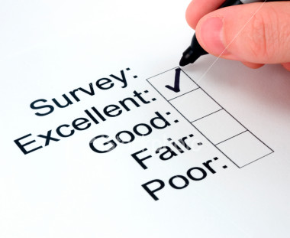
Getting to know your customer
It is in the best interest of an organization to get to KNOW their customers. The easiest way to understand a customer is to recognize a customer’s satisfaction and/or dissatisfaction.
At the end of the day…what do your customers like or dislike?
What are several methods that may be used to pinpoint customer satisfaction and/or dissatisfaction?
Customer Surveys
Customer Feedback Questionnaires
Customer Focus Groups
Customer Interviews
Customer Advisory groups

Slide 19
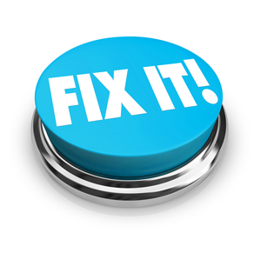
Categorizing Customer Turnoffs
Customer Turnoffs can be defined as “Actions or omissions on the part of the service provider that result in customer frustration and/or dissatisfaction”.
Through extensive research customer turnoffs can be categorized into three distinct categories:
Value Turnoffs
System Turnoffs
People Turnoffs

Slide 20

Value Turnoffs
In short, value turnoffs can be described as “not getting the value of what you have paid for”.
Example: You receive a 30 minute massage from the massage therapist in your chiropractors office, it is terrible. You feel like you have just been run over by a lawnmower, not to mention that the office has just raised the fees for a massage by 50%.
Value can be defined as: quality relative to price
Examples of value turnoffs:
Poor guarantee or failure to back up products
Quality not good as expected
Price too high for value received

Slide 21
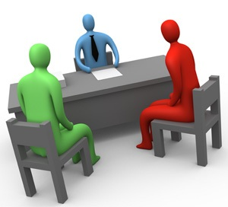
Where do value decisions originate from?
Value decisions usually come from management or the head of an organization. In a medical or dental facility value decisions may be regulated by a medical or dental board
The head of an organization will define what is called the;
value proposition—what the company intends to exchange with its customers.

Slide 22
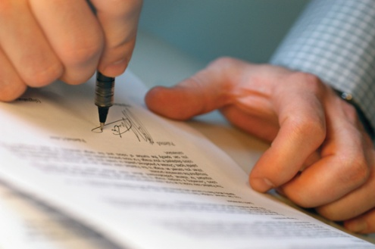
System Turnoffs
System turnoffs arise from the way a company delivers its products or services.
A system is - any process, procedure, or policy used to ‘Deliver’ the product or service to the customer. Systems are the processes that we use to get value to the customer.

Slide 23
System Turnoffs
Systems include things such as:
Company location, layout, parking facilities, phone lines
Employee training and staffing
Record keeping (including computer systems for handling customer transactions)
Policies regarding guarantees and product returns
Delivery or pickup services
Merchandise displays
Customer follow-up procedures
Billing and accounting processes

Slide 24
Where do system decisions originate from?
The responsibility for minimizing system turnoffs lies with managers, and owners. System changes often require spending organizational resources which are usually authorized by managers or the head of an organization.
A companies decision to add personnel, provide additional training, change locations or implement new delivery methods, will require management approval.
This does not mean that non-management employees should not be involved in suggesting system changes.
Customers may also indirectly be involved in system changes through customer feedback question, surveys etc…about company systems.

Slide 25
system turnoffs
Examples of system turnoffs:
Slow service
Long lines
Untrained employees
Poor signage
When transactions are unnecessarily complicated or inefficient (example: complicated forms)

Slide 26
System Turnoffs in a HOTEL RECEPTION
Can you think of a system turnoff in a hotel reception?
employees who lack the knowledge to answer customer questions
telephone menus that are unnecessarily complicated
poor location
cluttered workplace
lack of adequate seating
dirty facilities
clumsy or repetitious paperwork requirements
lack of parking
long periods of waiting
What do you think is the number one system turnoff according to customer research?
Slow service and/or having to wait

Slide 27
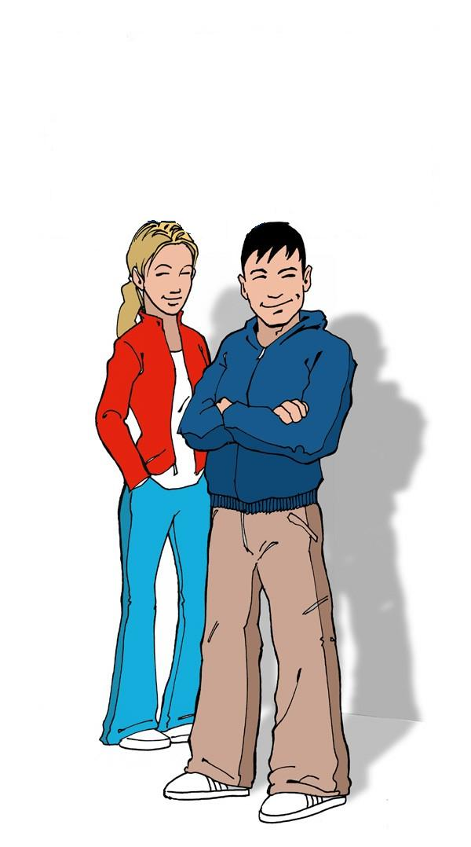
People Turnoffs
Employees that fail to communicate properly with words or nonverbally without words will almost always lead to people turnoffs.
Employees at all levels may create people turnoffs unconsciously.
This usually happens because people fail to understand how they are perceived by others
How can this be remedied? Use behaviours that engage customers and be aware of how and what you are communicating to a customer.
The responsibility for reducing people turnoffs lies with the employee.

Slide 28
Examples of People Turnoffs
Employees who fail to greet or even smile at a customer
People who give inaccurate information or convey a lack of knowledge
Employees chatting amongst themselves or allowing telephone interruptions while ignoring a customer
Behaviours that project a rude or uncaring attitude
Work locations that appear dirty or sloppy
Employees who are dressed inappropriately or have poor grooming
Any communicated message that causes the customer to feel uncomfortable

Slide 29
SUMMARY OF TURNOFFS
Value Turnoffs
Poor guarantee
Poor quality
Systems Turnoffs
Slow service
Business place dirty, messy, cluttered
People Turnoffs
Lack of courtesy, friendliness, attention
Employees who lack knowledge
Price too high
Low selection of products
Inconvenient location, layout, parking
Employee appearance

Slide 30
The customer zones
Zone 1: The Zone of Indifference
This includes all those customer needs and wants that are basic to fulfilling the contract between you and them.
For example, customers expect to be treated with courtesy and respect, but if you MEET but do not EXCEED these needs then the customer is said to feel INDIFFERENT.
They are neither SATISIFIED or DISSATISFIED by the service that they received.

Slide 31
The customer zones
Zone 2: The Zone of Satisfaction
This is where your customer actually TELLS you what is important to them. Listen carefully here, as this is a key stepping stone to customer loyalty.
Meeting a customer's needs here will cause SATISFACTION, whereas not meeting them will cause DISSATISFACTION.
For example, a customer might expect a volume discount on a purchase, but knows that they have to specifically ask (or negotiate) for it. It is an expectation, simply because other organizations that the customer deals with provide this benefit.

Slide 32
The customer zones
Zone 3: The Zone of Delight
This is where your customer HOPES for something, ASKS for it, but really does not expect you to provide it.
This is your opportunity to provide something beyond their expectations and by so doing will create DELIGHT.
For example, a customer might ask for something that is usually available only in a premium priced product.
Not providing it will unlikely cause dissatisfaction. Therefore this is an area for particular attention in building a LOYAL customer base.

Slide 33
The customer zones
Zone 4: The Zone of Loyalty
This is an area where your expertise in whatever product or service you provide and the customer's lack of expertise can really pay off!
Providing benefits above and beyond what the customer is even aware of can create a LOYAL customer. This requires you to be really proactive in suggesting to customers new innovations that they can really benefit from. Many customers will be even willing to pay extra for this.
For example, airbags in automobiles when first introduced were an innovation that saved lives, but customers had no way of asking for this innovation, or expecting it, before it became known to them.

Slide 34
The zone of indifference
Dissatisfied → Satisfied → Motivated
Zone of Indifference

Slide 35
Value Service Recovery
Problem Situations
Opportunity
Showing customers that you truly care is fundamental to building loyalty.

Slide 36
REASONS WHY CUSTOMERS COMPLAIN
Reasons why customers complain:
Emotional release from frustration
Show awareness of discrepancies between expectation and service
To give organisations a chance to correct deficiencies
To create an impression of being intelligent and discerning
To see if others (employees/customers) agree with their judgment
To solicit sympathy from the service provider
To feel in control by spreading negative publicity

Slide 37
RECOVERY STRATEGIES
Service recovery refers to the actions taken by a service organization in response to a service failure. Service failure is service performance that fails to meet the customer’s expectations. Some ways to execute service recovery are:
Acknowledge the problem
Take responsibility for the problem
Explain the cause of the problem
Correct the problem
Apologise for the inconvenience
Explain company rules or policies
Compensate/refund the customer
Present options/alternatives
Management intervention

Slide 38
CUSTOMER LOYALTY
What is customer loyalty?
Likelihood of previous customers to continue to buy from a specific organization.
When a person transacts with a brand (or purchases a specific product) on an ongoing basis.
It is both an attitudinal and behavioral tendency to favor one brand over all others, whether due to satisfaction with the product or service, its convenience or performance, or simply familiarity and comfort with the brand.
Loyalty can be defined as a customer continuing to believe that your organization’s product/service offer is their best option. It best fulfills their value proposition whatever that may be. They take that offer whenever faced with that purchasing decision.

Slide 39
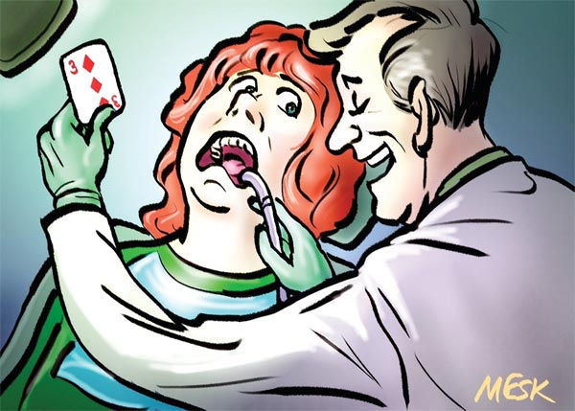
Creating Loyal Customers
A satisfied customer may not necessarily be a loyal, motivated or repeat customer.
A bad service experience may push the customer over the edge and lean them towards becoming a Dissatisfied Customer.
Service only becomes meaningful when it becomes and internal dynamic within an organization.
Customers’ quickly see the depth of a company’s commitment to service.
It is only when organizations realize that service is the foundation of any business that they will begin to serve customers effectively.

Slide 40
How to Create Loyal Customers
Reduce or eliminate value, systems and people turnoffs
Exceed customer expectations to create, positive awareness
Loyalty comes from customers awareness that “Service Is Your Business”
Look for turnoffs and determine who in the organization can best deal with each.
Employees at all levels should be aware of possible turnoffs.
Analysis of potential turnoffs must be an ongoing process.
Companies have to acknowledge that without their customers they would not exist.

Slide 41
BENEFITS OF CUSTOMER LOYALTY
Studies have shown that: a customer who encounters a problem with a company and that problem is addressed promptly and effectively—this customer will be more likely to remain loyal than a customer who never had a problem.
Even in cases where the customer’s problem was not resolved 100 percent in their favour, the loyalty still increases
Just the fact that the problem was acknowledged and addressed seems to be the key variable in strengthening the customer relationship

Slide 42
the five dimensions of service
Under the SERVQUAL model, the five dimensions of service are:
Reliability: where the quality and level of service is consistent
Assurance: knowledge and courtesy of staff and their ability to convey trust and confidence
Tangibles: the organization’s physical facilities, equipment, and appearance of staff
Empathy: the degree of caring, individualized attention that the organization’s staff provide to its customers
Responsiveness: the willingness of staff to help customers and provide prompt service
You can remember these five dimensions by using the acronym RATER. When these dimensions are consistently met, a company is well on its way to becoming customer oriented.

Slide 43
SERVICE CULTURE
What is Service Culture?
Service culture indicates that, for everyone in the provider organization, customer satisfaction is the top priority and that service provider activities demonstrably contribute to the business objectives of the customer.
A customer service culture is when a company's efforts are centered around the customer. This means that the entire company, even departments that do not normally interact with customers, are focused on the customer.
This also means that the company places value on each other in order to make sure they are delivering the best service to their customers all the time. There are many similar products and services in the market, so differentiating with customer service can set companies apart.

Slide 44
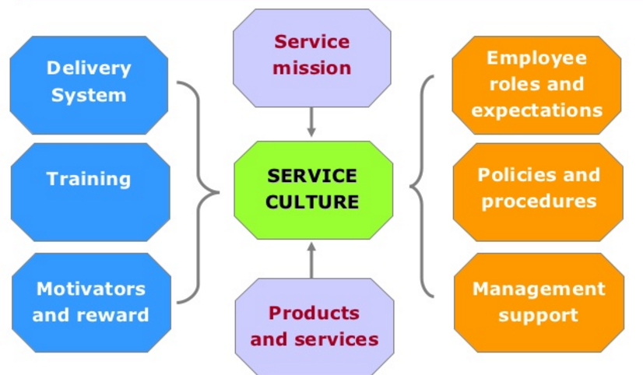
SERVICE CULTURE COMPONENTS

Slide 45
SERVICE CULTURE COMPONENTS
Service mission
The direction or vision of an organization that supports day-to-day interaction with the customer
Products and services
The material, products, and services that are state of the art, competitively priced, and meet the needs of customers
Delivery System
The way an organization deliver its products and services

Slide 46
SERVICE CULTURE COMPONENTS
Training
Instruction or information provided through a variety of techniques that teach knowledge or skills, or attempt to influence employee attitude toward excellent service delivery
Motivators and reward
Monetary rewards, material items, of feedback that prompts employees to continue to deliver service and perform at a high level of effectiveness and efficiency
Employee roles and expectations
The specific measures that indicates what is expected of employees in customer interactions and that define how employee service performance will be evaluated

Slide 47
SERVICE CULTURE COMPONENTS
Policies and procedures
The guidelines that establish how various situations of transactions will be handled
Management support
The availability of management to answer questions and assist frontline employees in customer interaction when necessary

Slide 48
Building a SERVICE CULTURE
To build a service culture, organisations must sustain focus on ‘The 12 Building Blocks’ of service culture support:
Service role modeling – Everyone is watching. Everyone is a service role model. Your leaders, managers and frontline staff consistently provide superior service to customers and to each other.
Common service language – Understood and frequently used by service providers at all levels and in all parts of the organisation, a common service language enables clear communication and supports the delivery of superior internal and external service.
Engaging service vision – Widely embraced and believed, an engaging service vision energises everyone in the organisation. Each person knows how the vision applies to their work and knows what action to take to make the vision real.

Slide 49
Building a SERVICE CULTURE
Service recruitment – Effective recruitment strategies and tactics attract people who support your organisation’s vision, and keep out those who may be technically qualified but not aligned with the service spirit and purpose of the organisation.
Service orientation – Your service orientation for new staff members is motivating, encouraging and effective. New team members feel welcome and inspired to contribute to your service culture.
Service communications – Service communications inform, educate and motivate the entire organisation. Creative communication channels surround everyone with relevant service information, timely customer feedback, uplifting success stories, and current challenges and objectives.

Slide 50
Building a SERVICE CULTURE
Service recognition and rewards – Recognition and reward motivate your team to celebrate service improvements. Incentives, acknowledgement, prizes, and praise all focus attention and encourage greater service results.
Voice of the customer – Effective customer contact and feedback systems capture current comments, compliments and complaints. This vital voice of the customer is anticipated and appreciated by every service provider in your organisation.
Service measures and metrics – Measuring what matters focuses attention and leads to positive results in many areas: market share, profitability, reputation, customer loyalty and satisfaction, employee engagement and performance improvement. This will help you understand the measurements to use and pitfalls to avoid.

Slide 51
Building a SERVICE CULTURE
Service improvement process – Continuous service improvement can be everyone’s ongoing project and passion. Engage your team members with workshops, initiatives, contests and suggestion programs that educate, motivate and empower.
Service recovery and guarantees – When things go wrong, bounce back! Effective service recovery and guarantees will turn upset customers into loyal advocates and team members into true believers.
Service benchmarking – Discover and apply best practices of leading organisations inside and outside your industry. Service benchmarking reveals what others do to improve their service, and points to new ways you can upgrade yours.

Slide 52
Practice QUESTION #1
Loyal customers are capable of generating more funds for any business organization because according to researchers there is a positive relationship between satisfied, loyal customers and profitability.
a. Give a suitable definition for customer loyalty. (3 mark)
b. Discuss any three (3) strategies that can be used to develop or maintain customer loyalty within an organization. (15 marks)
c. Clearly explain three (3) reasons for the poor delivery of customer service in some organizations and advise management on three (3) ways to correct these situations. (12 marks)
(Total 30 marks)

Slide 53
Practice QUESTION #2
Define ‘Customer Turnoff’.
(3 mark)
Identify the three (3) types of customer turnoffs.
(3 marks)
Give two (2) examples of the turnoffs identified in (b) above.
(6 marks)
Explain three (3) ways in which businesses can increase customer loyalty.
(18 marks)
(Total 30 Marks)

Slide 54
Advanced Reading
Unit 3 – The Psychology of Customer Flow
Customer Flow Management
Waiting Lines
Virtual Waiting
Technology

Slide 55
References
Customer Turnoffs from http://slidegur.com/doc/312901/customer-turnoffs#sample1
Moments of Truth from http://www.managementstudyguide.com/moment-of-truth-services-marketing.htm#
Customer Zones from http://www.managerwise.com/article.phtml?id=349
Customer loyalty definition from http://www.businessdictionary.com/definition/customer-loyalty.html and http://blog.accessdevelopment.com/what-is-the-definition-of-customer-loyalty
Service culture definition from http://www.knowledgetransfer.net/dictionary/ITIL/en/Service_Culture.htm
Building a service culture from http://ronkaufman.com/media_post/how-to-build-a-better-customer-service-culture-in-your-business/

